Slide 1
Definitions
A signal is a function which represents the time variation of a physical variable eg pressure, sound, temperature, data, speech, music, etc. A signal is thus a measured quantity that represents the physical variable.
A system generates a response, or output signal, for a given input. A system is thus a relationship between two signals.

Slide 2
Signal Representation
Continuous time, discrete time, analog and digital signal
A continuous time signal is one that is defined for all time instants, t, in an interval of interest. It is usually represented as a waveform
Example : f(t) values of f(.) defined for all time, t.
If f(t) can take any values in the interval , then it is considered an analog signal
If f(t) can take only values from a finite set where
at every time instant, then it is considered a digital signal

Slide 3
A discrete time signal is one that is defined only at specific time instants. It is usually represented as a sequence of numbers.
Example : f(n), n=0,1,2,…
If f(n) can take on any values in the interval , then it is considered an analog sequence
If f(n) can take only values from a set where at any time instant, then it is considered a digital sequence

Slide 4
Amplitude →
2
Continuous-time
(ANALOG SIGNAL)
0
Sampling
Perfect
Reconstruction
-2
-0.5
2.5
1.25
-2.75
1.75
-0.5
0.5
-1.25
1.5
⬅
Discrete-time
(ANALOG SEQUENCE)
Amplitude →
2
0
Quantization
-2
-1
3
1
-3
1
-1
1
-1
1
⬅
Discrete-time
(DIGITAL SEQUENCE)
Amplitude →
2
0
-2
Line
Coding
Amplitude →
2
Continuous-time
(DIGITAL SIGNAL)
0
-2
Time →

Slide 5
Deterministic or random signal
A deterministic signal is one in which its value is known and can be predicted exactly
Example : - At any time, t, is known exactly
A random signal is one in which its value is uncertain and cannot be predicted accurately.
Example : where can take on any value from the set with equal probability. At any instant time, t, cannot be determined exactly because it can take on values of ,
, with equal probability. In this case, can only be described by its statistics, such as its mean and variance.

Slide 6
Periodic or non-periodic signal
A periodic signal is one which satisfies the condition
where . The smallest value of is also called the fundamental period or simply the period of .
This signal satisfies for . The period of is .
The frequency of is Hertz if is in seconds.
Frequency can also be expressed in rads/sec,
A non-periodic or aperiodic signal is one which does not satisfy

Slide 7
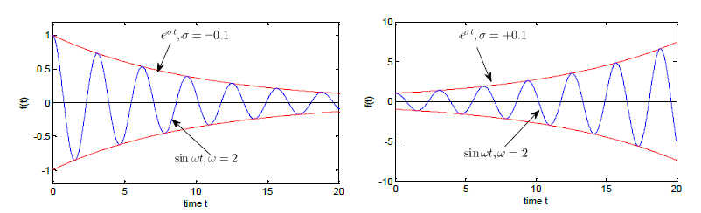
Bounded or unbounded signal
A signal is bounded if its magnitude does not go to infinity as goes to infinity.
A signal is unbounded if its magnitude goes to infinity as goes to infinity.
Complex exponential signal :

Slide 8
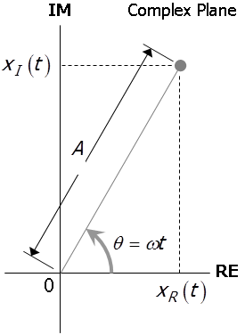
Real or Complex signal
A complex signal may be expressed as :

Slide 9
By applying Euler’s formula,
If or , then is a real signal
If or , then is an imaginary signal
A real signal can be made from two complex signals :
both terms are complex
conjugate of one another
where A* is the conjugate of A. You should be able to show that x(t) is no longer a complex function of t. Hence x(t) is real!

Slide 10
Sinusoidal signals or in short, sinuosoids
A sinusoidal signal is a general class of periodic signals of the form :
Real sinusoid
a.k.a. cosine
Real sinusoid
a.k.a. sine
Complex sinusoid
a.k.a. complex exponential
where
Notation :
f : frequency in Hz or cycles/sec
ω : frequency in rad/sec
Period, T, of sinusoid is given by either

Slide 11
Other basic signals
Unit Impulse (or Dirac-δ) function
0
and
Unit Step function
1
0
Sign (or Signum) function
1
0
-1
Rectangle function
1
0

Slide 12
Triangle function
1
-T
0
T
Sinc (Sine Cardinal) function
1
0
-4T
-3T
-2T
-T
T
2T
3T
4T
Dirac Comb function
1
1
1
1
1
1
1
-3T
-2T
-T
0
T
2T
3T

Slide 13
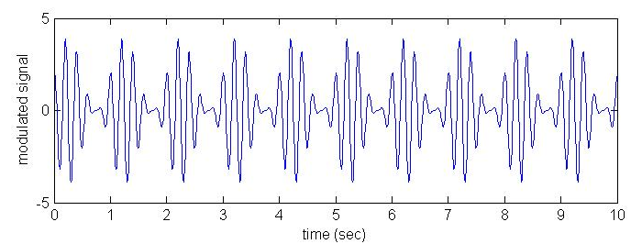
More Complicated signal : Amplitude Modulated Signal
Modulation technique used in radio signals
m(t) is the message to be transmitted and A_{c}cos ω_{c}t is the carrier signal

